Slide 1

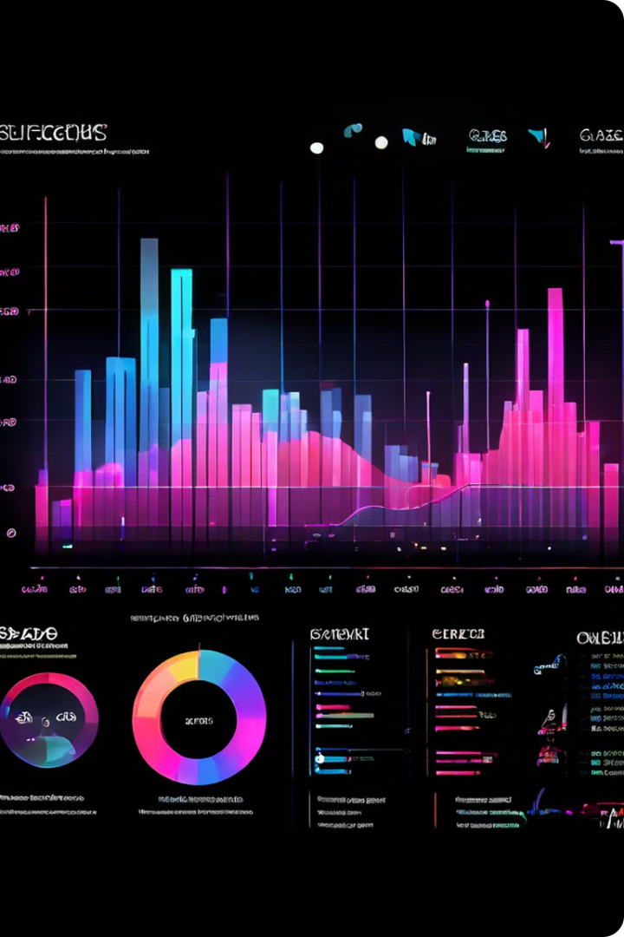
YouTube Songs Data Analysis Project
Welcome to the YouTube Songs Data Analysis Project! This project aims to uncover valuable insights from a comprehensive dataset of YouTube song data. Using Power BI, we'll explore various metrics to understand song performance, popularity trends, and user engagement patterns.
by Ahmed Hesham

Slide 2
Key Objectives and Scope
Song Performance Analysis
Popularity Trend Exploration
User Engagement Understanding
Analyze key metrics like view count, like count, comment count, and video duration to assess song performance and identify top-performing tracks.
Investigate the popularity of different genres, artists, and song release dates to understand current trends and identify emerging artists.
Examine user interactions, including likes, comments, shares, and subscriptions, to understand audience engagement patterns and identify factors that drive popularity.

Slide 3
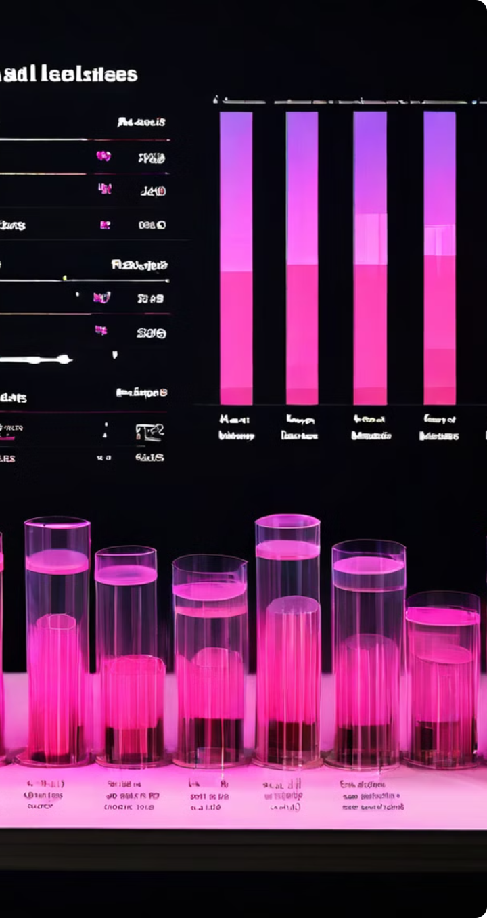
Data Overview: Attributes and Characteristics
Attribute
Description
video ID
Unique identifier for each YouTube video.
channel title
Name of the YouTube channel that uploaded the video.
title
Title of the song or video.
description
Textual description of the song or video.
tags
Keywords associated with the song or video.
published date
Date and time when the video was uploaded.
view count
Number of times the video has been viewed.
like count
Number of users who have liked the video.
favorite count
Number of users who have added the video to their favorites.
comment count
Number of comments posted on the video.
video duration
Length of the video in seconds.
video definition
Resolution of the video (e.g., 480p, 720p, 1080p).
caption details
Information about captions available for the video (e.g., language, availability).

Slide 4
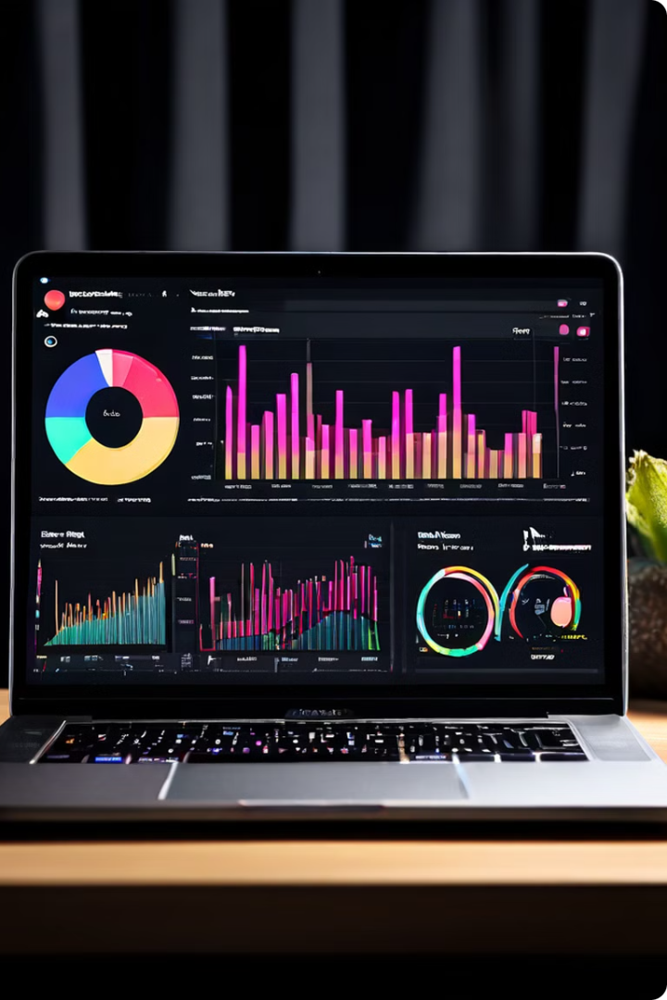
Power BI Visualization Approach
1
Interactive Dashboards
Create interactive dashboards with various visualizations, allowing users to explore data in a dynamic and engaging way.
2
Key Performance Indicators (KPIs)
Highlight key metrics like total views, average likes per view, and engagement rate using clear and concise KPIs.
3
Data Segmentation and Filtering
Enable users to filter and segment data by genre, artist, release date, and other relevant criteria to gain deeper insights.
4
Trend Analysis
Utilize line charts and other time-series visualizations to analyze trends in song popularity and user engagement over time.

Slide 5

Analyzing Song Performance Metrics
1
View Count Analysis
Identify top-performing songs based on total view count and analyze factors contributing to high viewership.
2
Like Count Analysis
Assess the level of user engagement by examining the ratio of likes to views and identifying songs with high like-to-view ratios.
3
Comment Count Analysis
Analyze the number of comments per video to understand the level of user interaction and identify songs that spark discussion.
4
Video Duration Analysis
Examine the correlation between video duration and performance metrics like view count and engagement to determine the ideal video length for YouTube songs.

Slide 6
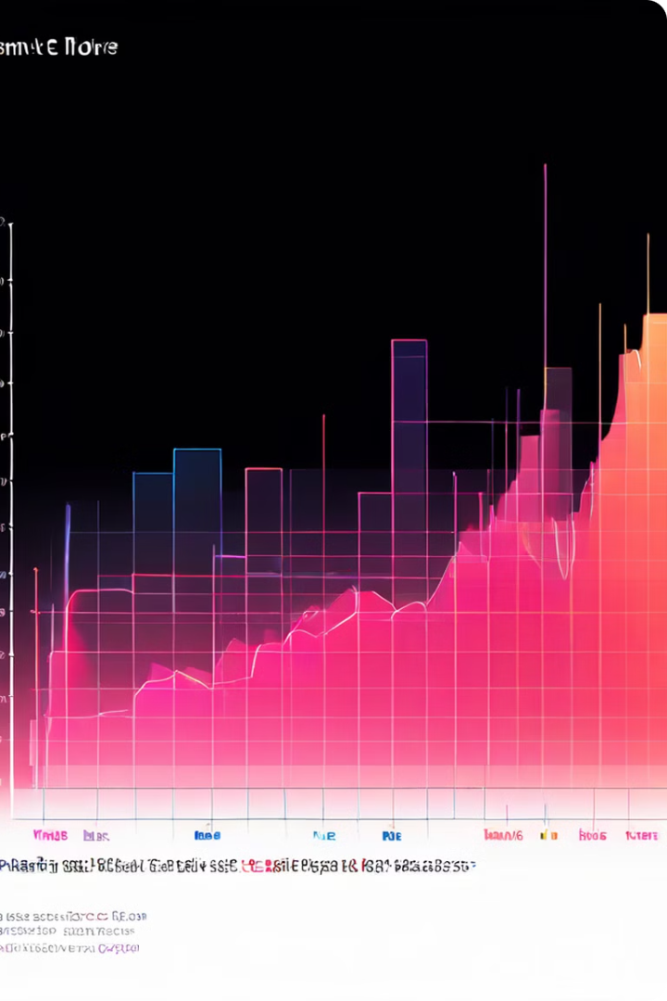



Exploring Popularity Trends
Genre Trend Analysis
Analyze the popularity of different music genres over time to identify emerging trends and understand audience preferences.
Artist Trend Analysis
Identify rising artists and track their popularity growth over time by analyzing their view count and engagement metrics.
Release Date Trend Analysis
Examine the impact of song release date on view count and engagement to understand the seasonality of music consumption.

Slide 7
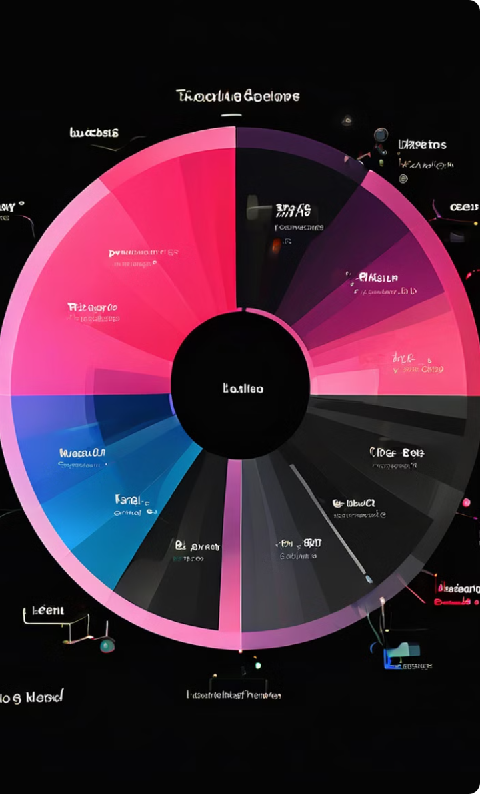



Understanding User Engagement Patterns
Like Analysis
Analyze the frequency of likes and understand factors influencing user preference for specific songs.
Comment Analysis
Identify themes and topics discussed in comments to understand user sentiment and engage in meaningful conversations.
Share Analysis
Examine the frequency of shares and identify factors that encourage users to spread the word about specific songs.
Subscription Analysis
Analyze the impact of song performance on channel subscriptions and understand how engaging content drives channel growth.

Slide 8
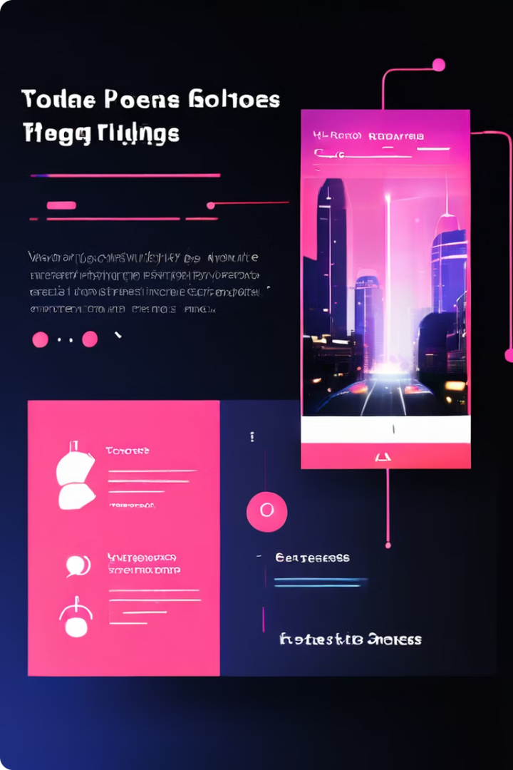
Insights and Recommendations
Genre Insights
Identify popular genres and target them with tailored content to attract a wider audience.
Artist Recommendations
Promote rising artists and leverage their growth potential to expand reach and engagement.
Engagement Optimization
Optimize video content and metadata to enhance user engagement and drive higher view count and interaction.
Content Strategy Recommendations
Develop a strategic content calendar based on popular trends and audience preferences to ensure consistent engagement.

